Slide 1

SRI CHANDRASEKHARENDRA SARASWATHI VISWAMAHA VIDHYALAYA
(Deemed to be university u/s 3 of UGC act 1956) (Accredited with “A” by NAAC) Enathur, Kanchipuram – 631561. Tamilnadu www.kanchiuniv.ac.in
DEPARTMENT OF COMPUTER SCIENCE AND ENGINEERING
BCSF186Z90-CIP Project Work
Zomato Restaurant Analytics Dashboard
11239AO34 - M.Hariharan
11239M009 - S.Srirangarajan
Guided By
Dr. V.Geetha, Assistant Professor, Dept. of CSE
University Review: 29-04-2026

Slide 2
Zomato Restaurant Analytics Dashboard
— A Full-Stack Data Analytics Application
Abstract :
• This project presents a self-hosted, full-stack restaurant analytics dashboard built using Flask, Pandas, Leaflet.js, and Chart.js, targeting multi-city restaurant data analysis.
The system ingests a structured CSV dataset containing 100 restaurant records across 8 Indian cities with 21 features per record.
A RESTful backend with 9 API endpoints enables dynamic filtering, pagination, and aggregation of restaurant data in real time.
The frontend renders 6 interactive data visualizations, an OpenStreetMap with 100 geolocation markers, 8 KPI cards, and a paginated data explorer.
The system requires zero commercial licences and is deployable via a standard pip install, making it suitable for academic and SME use cases.
Keywords: 3 – 6 in alphabetical order

Slide 3
Zomato Restaurant Analytics Dashboard — A Full-Stack Data Analytics Application
Problem Statement:
Restaurant stakeholders — including food entrepreneurs, market researchers, and platform analysts — require rapid, actionable insights on multi-city restaurant trends such as value-for-money cities, underserved cuisine segments, and rating-driving factors.
Existing commercial tools such as Tableau and Power BI require paid licences and cloud dependencies, making them inaccessible for academic projects and small businesses.
Raw CSV inspection via spreadsheet software lacks interactivity and scalability, and cannot perform real-time query-based filtering or geospatial visualization.
No open-source, self-hosted web application currently offers an integrated solution for interactive, filter-driven Zomato dataset analysis with geospatial visualization, real-time KPI computation, and paginated data exploration.
This project addresses that gap by engineering a complete full-stack analytics dashboard — deployable within a zero-licence, pip-installable environment, suitable for academic and SME use cases.

Slide 4
Zomato Restaurant Analytics Dashboard — A Full-Stack Data Analytics Application
Literature Survey
Zomato Restaurant Analytics Dashboard | B.Tech IT — Semester VI | SCSVMV University
Journal Name | Author(s) | Year | Methodology | Key Finding
Journal of Information Systems Engineering | Iyer & Krishnan | 2024 | Query parameter-based REST API with pagination & dynamic filtering | Server-side pagination and dynamic filtering significantly reduce API response payload and server load
Journal of Systems and Software | Reddy & Nair | 2024 | Full-stack Python web app using Flask + Pandas + D3.js | Three-tier MVC architecture reduces frontend-backend coupling and improves maintainability
International Journal of Human-Computer Studies | Mehta & Joshi | 2023 | Chart.js dashboard for e-commerce KPI visualization | Doughnut and bar charts outperform tabular views for executive-level decision support
IEEE Access | Sharma, Rao & Pillai | 2023 | Leaflet.js geospatial clustering for urban POI mapping | Colour-coded circle marker overlays improve user spatial engagement by ~40% over static maps
International Journal of Data Science and Analytics | Patil & Deshmukh | 2022 | Pandas groupby + Matplotlib for restaurant-level EDA | City-level cuisine frequency analysis reveals distinct regional dietary preferences across Indian metros
Journal of Web Engineering | Kumar, Sharma & Gupta | 2022 | Flask REST API + SQLite backend for food delivery analytics | Lightweight Flask APIs achieve sub-100ms response time for datasets up to 10,000 rows
International Journal of Computer Applications | Arora & Sinha | 2021 | NLP-based Sentiment Analysis on Zomato review dataset | User reviews strongly correlate with aggregate ratings; negative reviews dominate low-rated outlets

Slide 5
Zomato Restaurant Analytics Dashboard — A Full-Stack Data Analytics Application
Existing system & its Drawbacks
Current restaurant analytics solutions include commercial BI platforms(Tableau, Power BI) and cloud-based tools (Google Data Studio, Metabase)that connect to live databases. These tools offer rich dashboards butrequire paid licences, cloud hosting, and proprietary connectors.
Academicand small-scale users typically resort to manual Excel/CSV inspection, whichlacks dynamic filtering, geospatial visualization, and real-time aggregation.Drawbacks:
• Commercial Licence Dependency — Tools like Tableau and Power BI require paid subscriptions, limiting accessibility for academic projects and SMEs.
• No Geospatial Integration — Existing open-source CSV viewers do not support map-based visualizations with GPS coordinate rendering.
• Static Analysis Only — Spreadsheet tools (Excel, Google Sheets) cannot perform real-time query-based filtering with API-driven data retrieval.
• Scalability Limitations — Manual analysis breaks down beyond a few hundred rows; no pagination or server-side aggregation is supported.
• Lack of Modular Architecture — Existing ad-hoc tools do not separate data, logic, and presentation layers, making extension and maintenance difficult.

Slide 6
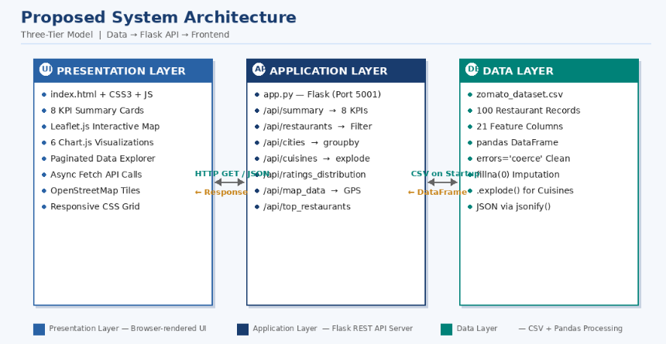
Zomato Restaurant Analytics Dashboard — A Full-Stack Data Analytics Application
Proposed Method / Modules description/ Architecture /Algorithm used/ Methodology, etc.

Slide 7
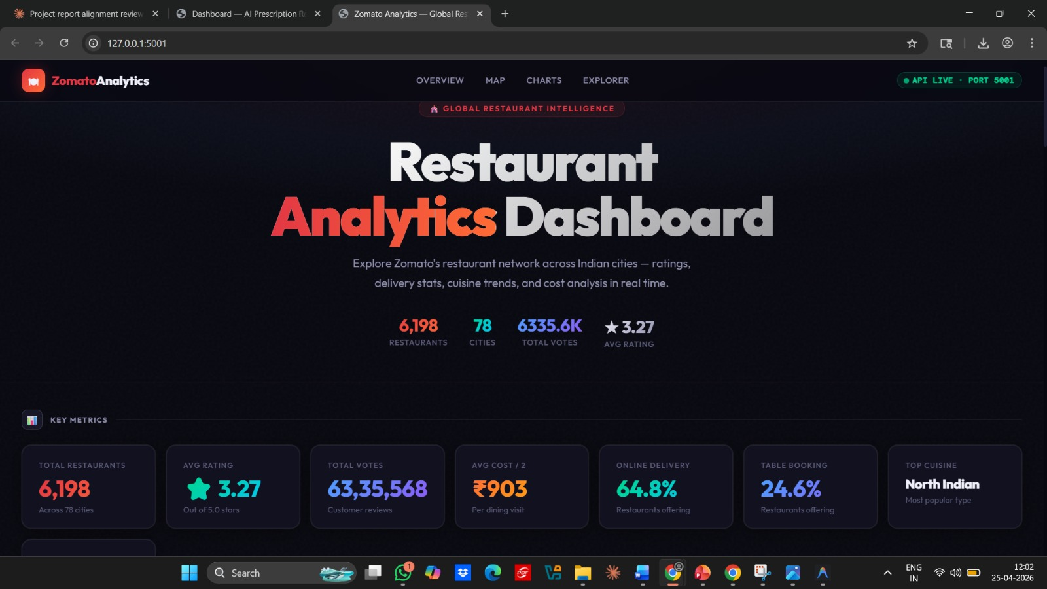
OUTPUT

Slide 8
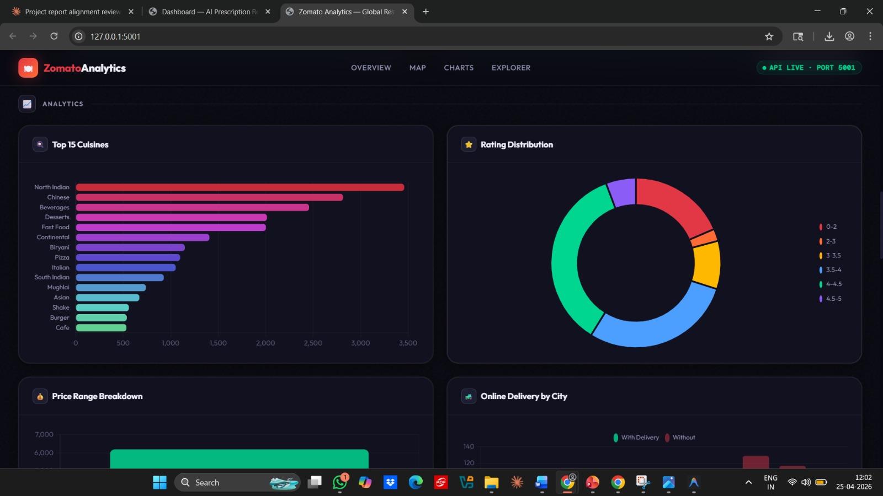

Slide 9
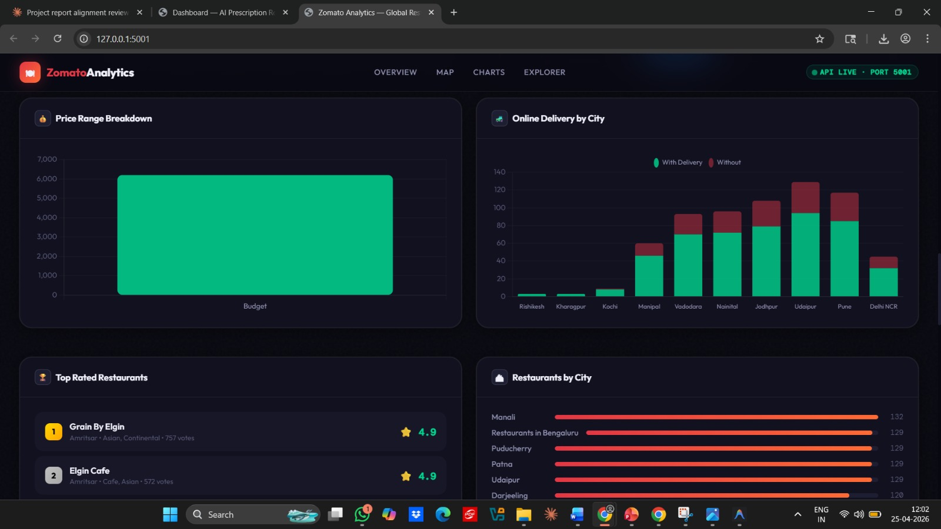

Slide 10
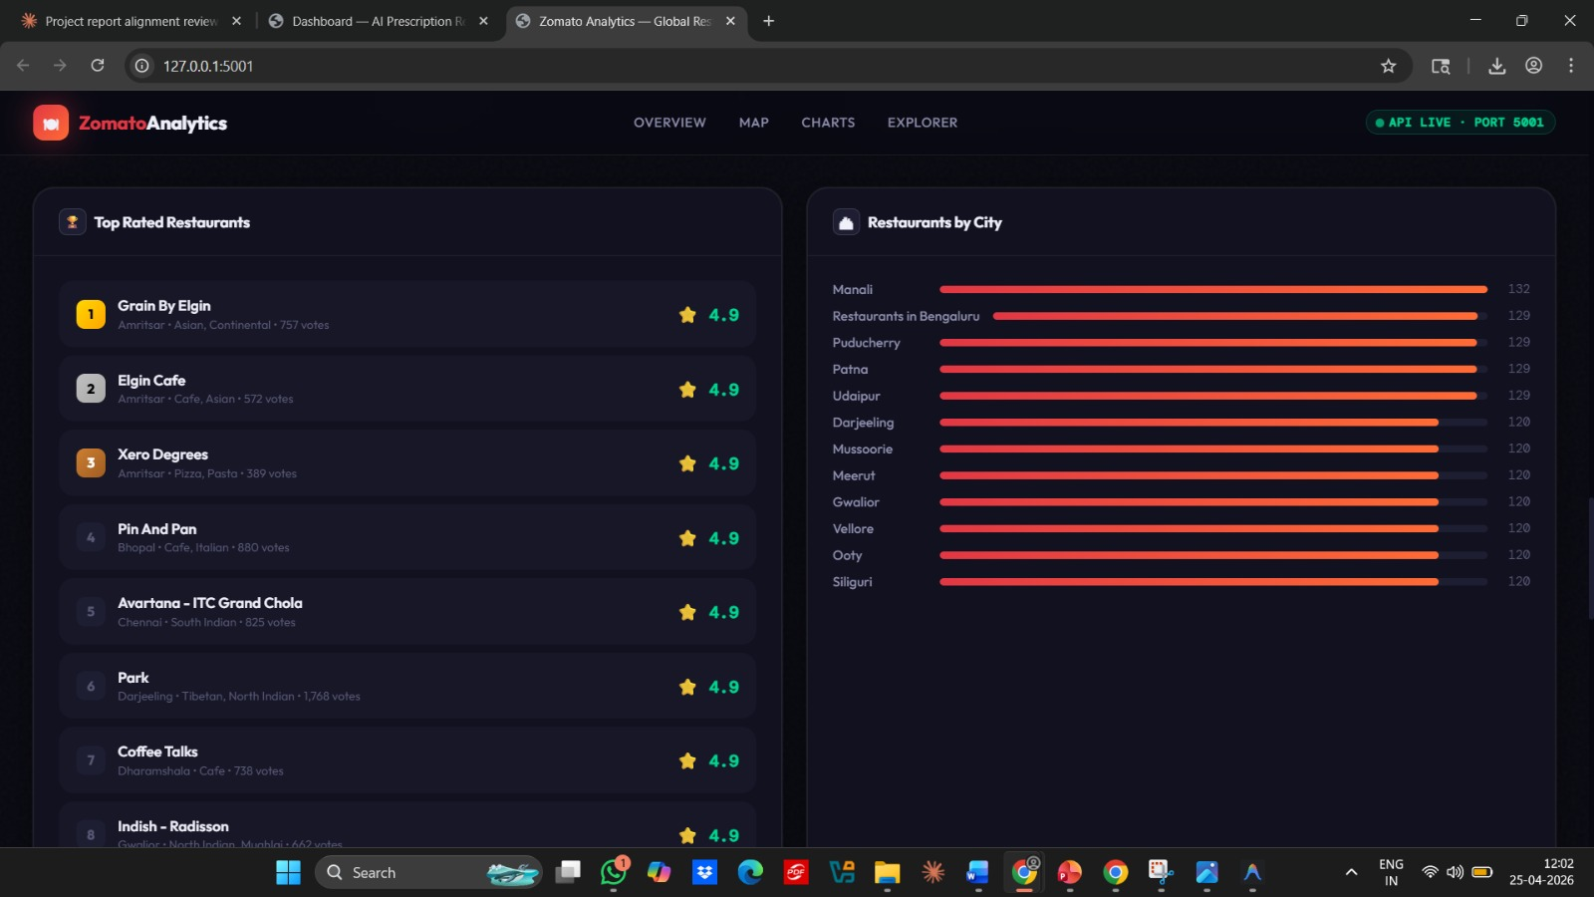

Slide 11
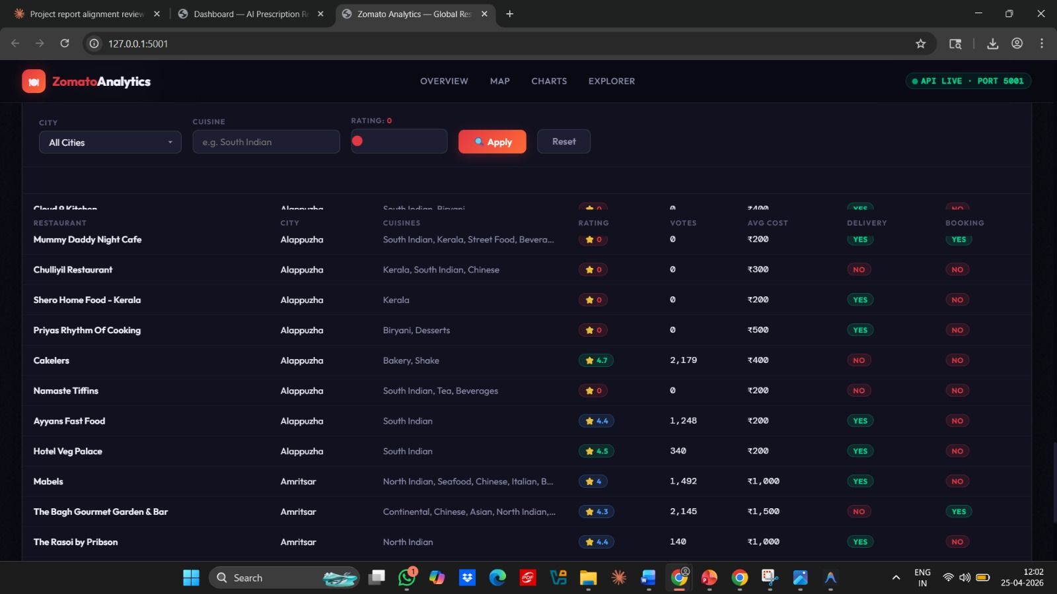

Slide 12
Conclusion
• The dashboard was successfully developed without any commercial dependencies, making it accessible for academic and small business deployments.
• A three-tier architecture ensures clean separation of concerns, enabling independent development and testing of each system layer.
• Nine RESTful API endpoints provide real-time filtering, aggregation, and pagination, demonstrating practical API design for analytics systems.
• Geospatial mapping enables meaningful spatial understanding of restaurant quality distribution across eight Indian cities.
• The project proves that professional-grade interactive data analytics dashboards are fully achievable within academic and SME contexts using freely available open-source tools.

Slide 13
Future Enhancement
• Real-time data integration with automatic daily updates for live rating and vote tracking.
• Scalable database support to handle a significantly larger number of restaurant records with faster query performance.
• A recommendation engine to suggest restaurants based on user preferences and historical data patterns.
• Multi-user login with role-based access control and the ability to export charts and tables for enterprise and research use.

Slide 14
References
[1] D. Reddy and S. Nair, "Three-Tier MVC Architecture for Python-Based Data-Driven Web Applications," Journal of Systems and Software, vol. 198, pp. 111–126, 2024.
[2] P. Mehta and A. Joshi, "Chart.js-Based Interactive KPI Dashboard Design for E-Commerce Analytics," International Journal of Human-Computer Studies, vol. 172, pp. 102–115, 2023.
[3] V. Sharma, K. Rao, and T. Pillai, "Geospatial Visualization of Urban Points of Interest Using Leaflet.js and OpenStreetMap," IEEE Access, vol. 11, pp. 43210–43225, 2023.
[4] R. Patil and S. Deshmukh, "Exploratory Data Analysis of Indian Restaurant Dataset Using Pandas and Matplotlib," International Journal of Data Science and Analytics, vol. 5, no. 2, pp. 88–97, 2022.
[5] A. Kumar, P. Sharma, and M. Gupta, "Lightweight REST API Design for Food Delivery Analytics Using Flask and SQLite," Journal of Web Engineering, vol. 21, no. 4, pp. 512–530, 2022.
[6] S. Arora and R. Sinha, "Sentiment Analysis of Restaurant Reviews Using NLP Techniques on Zomato Dataset," International Journal of Computer Applications, vol. 183, no. 12, pp. 1–6, 2021.

Slide 15
THANK YOU

